Slide 1

Gynecologic Emergencies
CHAPTER 24

Slide 2
National EMS Education Standard Competencies (1 of 3)
Medicine
Applies fundamental knowledge to provide basic emergency care and transportation based on assessment findings for an acutely ill patient.
Notes:
National EMS Education Standard Competencies
Medicine
Applies fundamental knowledge to provide basic emergency care and transportation based on assessment findings for an acutely ill patient.

Slide 3
National EMS Education Standard Competencies (2 of 3)
Gynecology
Recognition and management of shock associated with
  Vaginal bleeding
Notes:
National EMS Education Standard Competencies
Gynecology
• Recognition and management of shock associated with
Vaginal bleeding

Slide 4
National EMS Education Standard Competencies (3 of 3)
Anatomy, physiology, assessment findings, and management of
  Vaginal bleeding
  Sexual assault (to include appropriate emotional support)
  Infections
Notes:
National EMS Education Standard Competencies
• Anatomy, physiology, assessment findings, and management of
Vaginal bleeding
Sexual assault (to include appropriate emotional support)
Infections

Slide 5
Introduction
Women are uniquely designed to conceive and give birth.
Women are susceptible to problems that do not occur in men.
Notes:
Lecture Outline
I. Introduction
A. Women are uniquely designed to conceive and give birth.
1. Women are susceptible to a number of problems that do not occur in men.

Slide 6
Anatomy and Physiology (1 of 8)
External female genitalia
  Vaginal opening
  Labia majora and labia minora
  Clitoris
  Perineum
Notes:
Lecture Outline
II. Anatomy and Physiology
A. The female reproductive system includes internal and external structures.
B. External female genitalia
1. Vaginal opening
2. Labia majora and labia minora.
3. Clitoris
4. Perineum

Slide 7
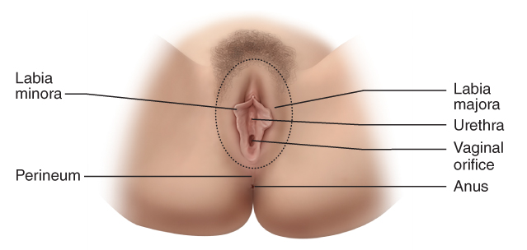
Anatomy and Physiology (2 of 8)
FIGURE 24-1 The external genitalia of the female reproductive system.
© Jones & Bartlett Learning.
Notes:
This figure shows the external female genitalia.

Slide 8
Anatomy and Physiology (3 of 8)
Ovaries are a primary internal female reproductive organ.
  Lie on each side of lower abdomen
  Produce ovum (egg)
Fallopian tubes connect each ovary with the uterus.
Notes:
Lecture Outline
C. Internal structures
1. Ovaries lie on each side of the lower abdomen and produce an ovum (egg).
2. Fallopian tubes connect each ovary with the uterus.

Slide 9
Anatomy and Physiology (4 of 8)
Uterus is a muscular organ where the fetus grows.
  Narrowest part of uterus is the cervix
  Cervix opens into the vagina
Vagina is outermost cavity of woman’s reproductive system.
  Forms the lower part of birth canal
Notes:
Lecture Outline
3. The uterus is the muscular organ where the fetus grows during pregnancy.
4. The narrowest part of the uterus is the cervix, which opens into the vagina.
5. The vagina is the outermost cavity of a woman’s reproductive system.

Slide 10
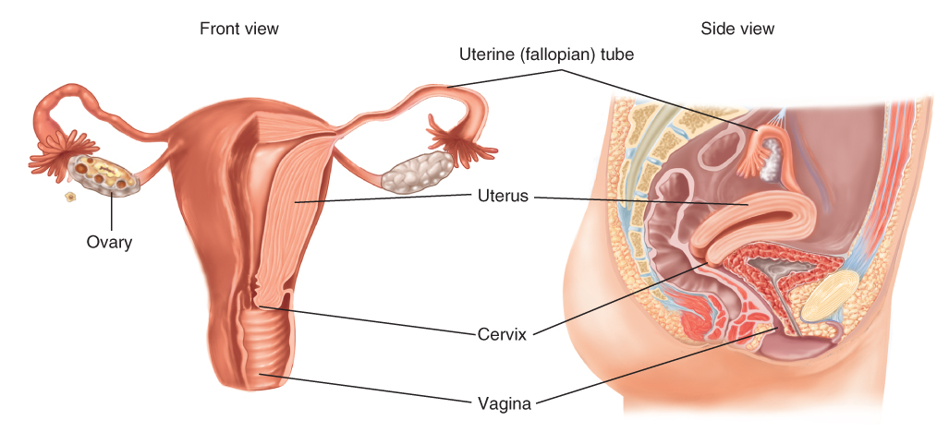
Anatomy and Physiology (5 of 8)
FIGURE 24-2 Anterior and lateral views of the female reproductive system.
© Jones & Bartlett Learning
Notes:
This figure shows the internal female genitalia.

Slide 11
Anatomy and Physiology (6 of 8)
Ovulation and menstruation begin in puberty.
  Onset of menstruation is called menarche.
  Occurs between age 11 and 16 years
Women continue ovulation and menstruation until menopause.
  Occurs around age 50
Notes:
Lecture Outline
D. When a female reaches puberty, she begins to ovulate and experience menstruation.
1. Menarche (onset of menstruation) usually occurs between age 11 and 16 years.
a. Any female who reaches menarche is capable of becoming pregnant.
E. Women continue the cycle of ovulation and menstruation until they reach menopause.
1. The end of menstrual activity usually occurs around age 50.

Slide 12
Anatomy and Physiology (7 of 8)
Each ovary produces an ovum in alternating months (ovulation).
The process of fertilization begins in the vagina.
  Sperm are deposited from the male penis, passes through cervix to uterus, and up the fallopian tubes.
  Embryo travels into the uterus, attaches to the uterine wall, and continues to grow.
Notes:
Lecture Outline
F. Each month one ovum is released into the fallopian tube (ovulation).
G. The process of fertilization begins in the vagina.
1. Sperm are deposited into the vagina from the male penis.
a. Sperm pass through the cervix into the uterus and eventually up the fallopian tubes, where the ovum is fertilized.
b. The embryo travels into the uterus, attaches to the uterine wall, and continues to grow.

Slide 13
Anatomy and Physiology (8 of 8)
If fertilization does not occur within about 14 days of ovulation:
  The lining of the uterus begins to separate, and menstruation occurs for about a week.
Process of ovulation and menstruation is controlled by female hormones.
Notes:
Lecture Outline
H. If fertilization does not occur within about 14 days of ovulation, the lining of the uterus begins to separate, and menstruation occurs.
I. Female hormones, produced primarily in the ovaries, control the process of ovulation and menstruation.

Slide 14
Pathophysiology
Causes of gynecologic emergencies are varied.
  Range from sexually transmitted diseases to trauma
Notes:
Lecture Outline
III. Pathophysiology
A. The causes of gynecologic emergencies are varied, ranging from sexually transmitted diseases to trauma.

Slide 15
Pelvic Inflammatory Disease (PID)
Infection of upper organs of reproduction
  Occurs almost exclusively in sexually active women
  Can result in increased risk of ectopic pregnancy or sterility
  Most common sign is generalized lower abdominal pain
Notes:
Lecture Outline
B. Pelvic inflammatory disease (PID)
1. Infection of the upper organs of reproduction
a. Occurs almost exclusively in sexually active women
b. If infection expands to fallopian tubes, it will cause scarring.
i. Can result in increased risk of ectopic pregnancy or sterility
c. If infection expands to ovaries, it can lead to the development of a life-threatening abscess.
2. Most common presenting sign of PID is generalized lower abdominal pain.
a. Other signs include abnormal or foul-smelling vaginal discharge, increased pain with intercourse, fever, general malaise, and nausea and vomiting.
3. Risk factors
a. Multiple sex partners and/or a partner who has had multiple sex partners
b. Untreated sexually transmitted disease
c. Past history of PID
d. Being sexually active
e. Younger than 26 years of age
f. Douching
g. Using an IUD for birth control

Slide 16
Sexually Transmitted Diseases (1 of 3)
STDs can lead to more serious conditions, such as PID.
Chlamydia
  Most common STD
  Caused by bacteria
  Usually mild or absent symptoms
  Can spread to rectum and progress to PID
Notes:
Lecture Outline
C. Sexually transmitted diseases (STDs)
1. STDs can lead to more serious conditions, such as PID.
2. Chlamydia
a. Most common STD in the United States
b. Usually mild or absent symptoms
c. Infection of the cervix can spread to the rectum and can progress to PID.

Slide 17
Sexually Transmitted Diseases (2 of 3)
Bacterial vaginosis
  Most common vaginal infection
  Affects women ages 15 to 44 years
  Normal bacteria in vagina are replaced by an overgrowth of other bacteria.
  Untreated, it can progress to premature birth or low birth weight in pregnancy, and PID.
Notes:
Lecture Outline
2. Bacterial vaginosis
a. Most common vaginal infection to afflict women ages 15–44 years
b. Untreated, it can lead to premature birth or low birth weight in case of pregnancy, make the patient more susceptible to other serious infections, and cause PID.

Slide 18
Sexually Transmitted Diseases (3 of 3)
Gonorrhea
  Grows and multiplies rapidly in warm, moist areas of reproductive tract
    Cervix, uterus, fallopian tubes in women
    Urethra in men and women
  If untreated, can enter bloodstream and spread to other parts of body
Notes:
Lecture Outline
3. Gonorrhea
a. Caused by bacteria that grow and multiply rapidly in warm, moist areas of reproductive tract
i. Cervix, uterus, fallopian tubes in women
ii. Urethra in men and women
b. Severe infections present with cramping and abdominal pain, nausea, vomiting, and bleeding between periods.
c. Untreated, it can enter the bloodstream and spread to other parts of the body, including the brain.

Slide 19
Vaginal Bleeding
Possible causes include:
  Abnormal menstruation
  Vaginal trauma
  Ectopic pregnancy
  Spontaneous abortion
  Cervical polyps or cancer
Notes:
Lecture Outline
D. Vaginal bleeding
1. Possible causes include:
a. Abnormal menstruation
b. Vaginal trauma
c. Ectopic pregnancy
d. Spontaneous abortion
e. Cervical polyps
f. Cancer

Slide 20
Patient Assessment
Obtaining an accurate and detailed assessment is critical.
  You will be able to gain only a primary impression of the problem in the field.
  Thorough patient assessment will help determine how sick the patient is and whether life-saving measures are needed.
Notes:
Lecture Outline
IV. Patient Assessment
A. Obtaining an accurate and detailed assessment is critical when dealing with gynecologic issues.

Slide 21
Scene Size-up (1 of 2)
Scene safety
Gynecologic emergencies can involve large amounts of blood and body fluid.
Involve police if assault is suspected.
  In sexual assault, it is important to have a female EMT provide care.
Notes:
Lecture Outline
B. Scene size-up
1. Scene safety
a. Is the scene safe?
i. Will you need assistance?
ii. How many patients do you have?
iii. What is the nature of the illness?
iv. Have you taken standard precautions?
b. Gynecologic emergencies can involve large amounts of blood and body fluids potentially contaminated with organisms that can cause communicable diseases.
c. Where or in what position is the patient found?
d. If she is at home, what is the condition of the residence?
e. If a crime scene, you may be required to testify in court regarding conditions on your arrival. Your documentation needs to be accurate and thorough.
f. Involve the police if any type of assault is suspected.
g. In cases of sexual assault, it is important to have a female EMT provide patient care.

Slide 22
Scene Size-up (2 of 2)
Sometimes the MOI may be easily understood from the dispatch information, such as sexual assault.
In other patients, patient history may reveal the nature of the condition.
Notes:
Lecture Outline
2. Mechanism of injury (MOI)
a. The MOI in some patients with gynecologic problems may be easily understood from the dispatch information, such as sexual assault.
b. In other patients, patient history may reveal the nature of the condition.

Slide 23
Primary Assessment (1 of 2)
Form a general impression.
  Is the patient stable or unstable?
  Use AVPU scale.
Airway and breathing
  Always evaluate first to ensure adequacy.
Circulation
  Pulse and skin color, temperature, and moisture can help identify blood loss.
Notes:
Lecture Outline
C. Primary Assessment
1. Form a general impression.
a. Is the patient stable or unstable?
b. Use the AVPU scale to determine the patient’s level of consciousness.
2. Always evaluate the airway and breathing immediately to ensure they are adequate.
3. Palpate a pulse and evaluate skin color, temperature, and moisture to help identify blood loss in a patient.

Slide 24
Primary Assessment (2 of 2)
Most gynecologic emergencies are not life threatening.
If the patient has signs of shock, rapid transport is warranted.
Notes:
Lecture Outline
4. Most cases of gynecologic emergencies are not life threatening
a. If patient has signs of shock, then rapid transport is warranted.

Slide 25
History Taking (1 of 4)
Investigate chief complaint.
  Some questions are extremely personal.
  Ensure the patient’s privacy and dignity are protected.
Notes:
Lecture Outline
D. History taking
1. Investigate chief complaint.
a. Some questions may be extremely personal to the patient.
b. Be sensitive to the patient’s feelings and protect her privacy and dignity.

Slide 26
History Taking (2 of 4)
For abdominal pain, ask about:
  Onset, duration, quality, and radiation
  Provoking or relieving factors
  Associated symptoms such as syncope, light-headedness, nausea, vomiting, and fever
Notes:
Lecture Outline
2. For abdominal pain, ask about onset, duration, quality, and radiation; provoking or relieving factors; and associated symptoms such as syncope, light-headedness, nausea, vomiting, and fever.

Slide 27
History Taking (3 of 4)
For vaginal bleeding, ask about:
  Onset
  Duration
  Quantity (number of sanitary pads soaked)
  Associated symptoms such as syncope and light-headedness
Notes:
Lecture Outline
3. For vaginal bleeding, ask about onset, duration, quantity (number of sanitary pads soaked), and associated symptoms such as syncope and light-headedness.

Slide 28
History Taking (4 of 4)
SAMPLE History
  Ask about birth control pills or devices.
  Ask about medical conditions and last menstrual cycle.
Notes:
Lecture Outline
4. SAMPLE history
a. Ask about birth control pills and devices
b. Ask patient about medical conditions and last menstrual period.

Slide 29
Secondary Assessment (1 of 4)
Pertinent secondary assessment findings should include:
  Vital signs: blood pressure, pulse, skin color, orthostatic vital signs
  Abdomen: distention and tenderness
  Genitourinary: visible bleeding
  Neurologic: mental status
Notes:
Lecture Outline
E. Secondary assessment
1. Pertinent secondary assessment findings should include:
a. Vital signs: blood pressure, pulse, skin color, orthostatic vital signs
b. Abdomen: distention and tenderness
c. Genitourinary: visible bleeding
d. Neurologic: mental status

Slide 30
Secondary Assessment (2 of 4)
Physical examinations
  Should be limited and professional
  Only examine the genitalia if necessary to treat the patient.
Patients age 65+ may have concerns related to hormone replacement therapy, cancer, pelvic floor collapse, or urinary incontinence.
Notes:
Lecture Outline
3. Physical examinations
a. Should be limited and professional
i. Only examine the genitalia if it is necessary to do so to treat the patient.
b. Patients age 65 years and older may have concerns related to hormone replacement therapy, cancer, pelvic floor collapse, or urinary incontinence.

Slide 31
Secondary Assessment (3 of 4)
Vaginal bleeding:
  Visualize the bleeding and ask about quality and quantity.
  Use external pads to control bleeding.
Observe for vaginal discharge.
Syncope, fever, nausea, and vomiting are significant in gynecologic emergencies.
Notes:
Lecture Outline
c. For vaginal bleeding: visualize the bleeding and ask about quality and quantity.
d. Observe for vaginal discharge.
e. Fever, nausea, and vomiting are considered significant in gynecologic emergencies.
f. Syncope is considered significant; treat as being in shock until proven otherwise.

Slide 32
Secondary Assessment (4 of 4)
Vital signs
  Assess patient’s:
    Heart rate, rhythm, and quality
    Respiratory rate, rhythm, and quality
    Skin color, temperature, and condition
    Capillary refill time
    Blood pressure
    Consider orthostatic vital signs
    Consider noninvasive blood pressure monitoring to continuously track patient’s blood pressure.
Notes:
Lecture Outline
3. Assess the patient’s:
a. Heart rate, rhythm, and quality
b Respiratory rate, rhythm, and quality
c. Skin color, temperature, and condition
d. Capillary refill time
e. Blood pressure
f. Consider obtaining orthostatic vital signs if bleeding is known or suspected.

Slide 33
Reassessment (1 of 2)
Repeat the primary assessment.
There are very few interventions with a gynecologic emergency.
Notes:
Lecture Outline
F. Reassessment
1. Repeat the primary assessment.
2. There are very few interventions with a gynecologic emergency.

Slide 34
Reassessment (2 of 2)
Communication and documentation
  Communicate all relevant information to staff at receiving hospital.
    Include possibility of pregnancy
  Carefully document everything, especially in cases of sexual assault.
Notes:
Lecture Outline
3. Communicate all relevant information to the staff at the receiving hospital, including the possibility of pregnancy.

Slide 35
Emergency Medical Care (1 of 3)
Maintain patient’s privacy as much as possible.
  If in a public place, move to ambulance.
  Have a female EMT participate in the patient’s care if possible.
Notes:
Lecture Outline
V. Emergency Medical Care
A. Maintain the patient’s privacy as much as possible.
1. If in a public place, move her to the ambulance.
2. Have a female EMT participate in the patient’s care if possible.

Slide 36
Emergency Medical Care (2 of 3)
Use sanitary pads on the external genitalia to absorb blood.
  Document the number of pads saturated in blood.
External genitals have a rich nerve supply.
  Makes injuries very painful
Notes:
Lecture Outline
B. Excessive internal vaginal bleeding
1. Use sanitary pads on the external genitalia to absorb the blood.
2. Document the number of sanitary pads that were saturated with blood.
C. The external genitals have a rich nerve supply.
1. This makes injuries to the area very painful.

Slide 37
Emergency Medical Care (3 of 3)
Treat external lacerations with moist, sterile compresses.
  Do not pack or place dressings in the vagina.
Notes:
Lecture Outline
2. Treat external lacerations, abrasions, or tears with sterile compresses.
a. Under no circumstances should you pack or place dressings in the vagina.

Slide 38
Assessment and Management of Specific Conditions
Pelvic inflammatory disease (PID)
  A patient with PID will complain of abdominal pain.
    Usually starts during or after menstruation
    May be made worse by walking
  Prehospital treatment is limited.
  Nonemergency transport is usually recommended.
Notes:
Lecture Outline
VI. Assessment and Management of Specific Conditions
A. Pelvic inflammatory disease (PID)
1. A patient with PID will complain of abdominal pain.
a. Pain usually starts during or after normal menstruation.
b. The pain may be made worse by walking. Patients often present with a distinctive gait that appears as a shuffle.
2. Prehospital treatment is limited.
3. Nonemergency transport is usually recommended.

Slide 39
Sexual Assault (1 of 5)
Sexual assault and rape are common.
  1 of 5 women has reported being raped.
  1 of 3 women will be sexually molested.
EMTs treating victims of sexual assault face many complex issues.
Notes:
Lecture Outline
B. Sexual assault
1. Sexual assault and rape are common in the United States.
a. One in five women has reported being raped.
b. One in three women will be sexually molested, often before the age of 12 years.
2. EMTs called on to treat a victim of sexual assault face many complex issues.
a. Issues range from obvious medical ones to serious psychological and legal issues.

Slide 40
Sexual Assault (2 of 5)
You may be first person victim has contact with after the encounter.
  Professionalism, tact, kindness, and sensitivity, are important.
Notes:
Lecture Outline
3. You may be the first person the victim has contact with after the encounter.
a. Professionalism, tact, kindness, and sensitivity are important.

Slide 41
Sexual Assault (3 of 5)
Be aware of drugs used to facilitate sexual assault or rape.
If possible, give the patient the option of being treated by a female EMT.
Notes:
Lecture Outline
4. When performing your assessment, be aware of drugs used during sexual assault or rape to incapacitate a person.
5. If possible, give the patient the option of being treated by a female EMT.

Slide 42
Sexual Assault (4 of 5)
Your focus should be:
  Provide medical treatment of patient.
  Offer psychological care of patient.
  Preserve evidence.
  Take history.
  Produce a patient care report.
Notes:
Lecture Outline
6. Your focus should be:
a. Medical treatment of patient
b. Psychological care of patient
c. Preserve evidence
7. It may be necessary to persuade the patient not to clean herself.
8. Offer to call the local rape crisis center for the patient.
9. Take the patient’s history and limit any physical examination to a brief survey for life-threatening injuries.

Slide 43
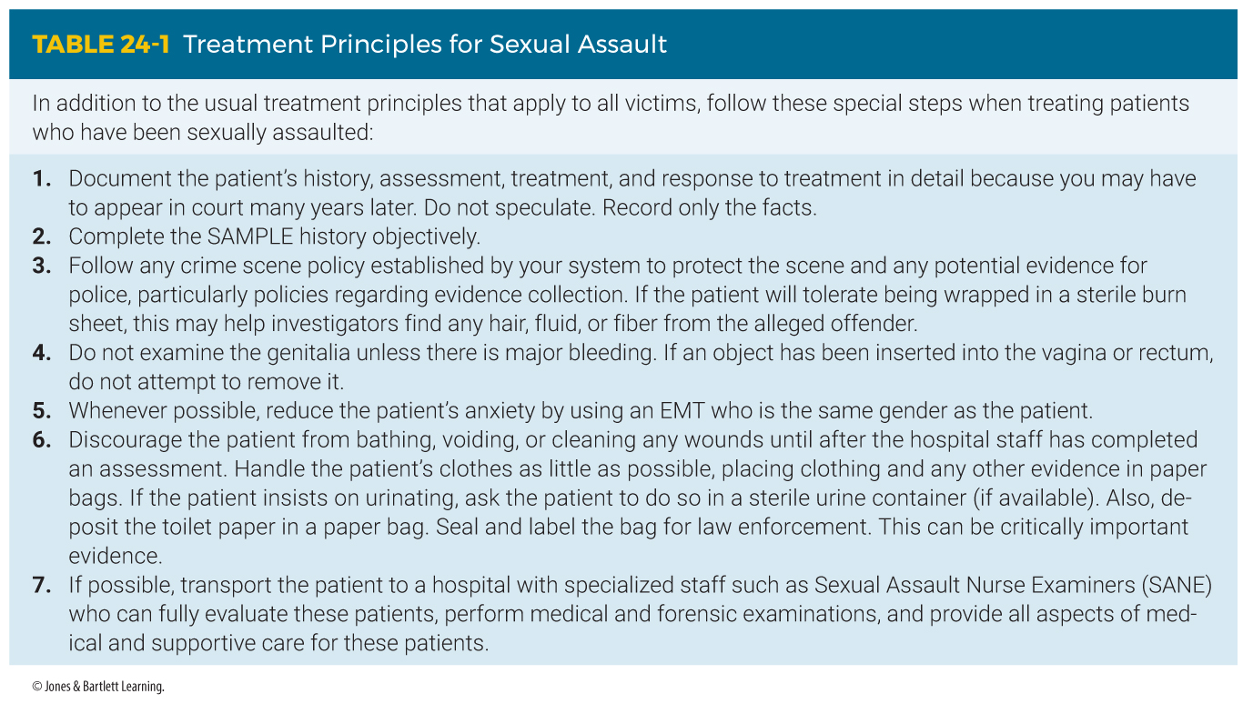
Sexual Assault (5 of 5)
Notes:
This table shows treatment principles for victims of sexual assault.

Slide 44
Review
What is the narrowest portion of the uterus?
  Vagina
  Cervix
  Fallopian tubes
  Ovaries

Slide 45
Review
Answer: B
Rationale: The ovaries are the primary female reproductive organ. The developing embryo travels into the uterus through the fallopian tube. The embryo attaches to the uterine wall and continues to grow. The narrowest portion of the uterus is the cervix, which opens into the vagina.

Slide 46
Review
What is the narrowest portion of the uterus?
  Vagina
  Rationale: The vagina is the outermost cavity of the woman’s reproductive system.
  Cervix
  Rationale: Correct answer
  Fallopian tube
  Rationale: The fallopian tubes are not part of the uterus. They connect each ovary with the uterus.
  Ovaries
  Rationale: The ovaries are located on each side of the abdomen and are not part of the uterus.

Slide 47
Review
What is the outermost cavity of a woman’s reproductive system?
  Cervix
  Ovaries
  Vagina
  Uterus

Slide 48
Review
Answer: C
Rationale: The vagina is the outermost cavity of a woman’s reproductive system.

Slide 49
Review
What is the outermost cavity of a woman’s reproductive system?
  Cervix
  Rationale: The cervix opens into the vagina. Sperm passes through the cervix to the uterus and up the fallopian tubes.
  Ovaries
  Rationale: The ovaries are located on each side of the lower abdomen.
  Vagina
  Rationale: Correct answer
  Uterus
  Rationale: The uterus is the muscular organ where the fetus grows during pregnancy.

Slide 50
Review
If fertilization has not occurred within about ___ days following ovulation, the lining of the uterus begins to separate, and menstruation occurs.
  8
  10
  12
  14

Slide 51
Review
Answer: D
Rationale: Women menstruate about 14 days following ovulation.

Slide 52
Review
If fertilization has not occurred within about ___ days following ovulation, the lining of the uterus begins to separate, and menstruation occurs.
  8
  Rationale: Women menstruate about 14 days following ovulation.
  10
  Rationale: Women menstruate about 14 days following ovulation.
  12
  Rationale: Women menstruate about 14 days following ovulation.
  14
  Rationale: Correct answer.

Slide 53
Review
The onset of menstruation is called:
  menopause.
  menarche.
  ovulation.
  bleeding.

Slide 54
Review
Answer: B
Rationale: Menarche is the onset of menstruation, typically occurring between the ages of 11 and 16 years.

Slide 55
Review
The onset of menstruation is called:
  menopause.
  Rationale: Menopause is when the cycle of ovulation and menstruation cease.
  menarche.
  Rationale: Correct answer
  ovulation.
  Rationale: Ovulation occurs each month when one ovum is released into the fallopian tube.
  premenstrual syndrome
  Rationale: Premenstrual syndrome involves symptoms that typically occur before menstruation.

Slide 56
Review
Which of the following can cause vaginal bleeding?
  Ectopic pregnancy
  Spontaneous abortion
  Trauma
  All of the above.

Slide 57
Review
Answer: D
Rationale: Ectopic pregnancy, spontaneous abortion, and trauma can cause vaginal bleeding and should not be overlooked.

Slide 58
Review
Which of the following can cause vaginal bleeding?
  Ectopic pregnancy
  Rationale: Ectopic pregnancy can cause vaginal bleeding.
  Spontaneous abortion
  Rationale: Spontaneous abortion can cause vaginal bleeding.
  Trauma
  Rationale: Trauma can cause vaginal bleeding.
  All of the above.
  Rationale: Correct answer.

Slide 59
Review
What is the most common presenting sign of PID?
  Vomiting
  Vaginal discharge
  Lower abdominal pain
  Fever

Slide 60
Review
Answer: C
Rationale: Lower abdominal pain is the most common sign of pelvic inflammatory disease.

Slide 61
Review
What is the most common presenting sign of PID?
  Vomiting
  Rationale: Vomiting is considered to be another sign of PID.
  Vaginal discharge
  Rationale: Vaginal discharge is considered to be another sign of PID.
  Lower abdominal pain
  Rationale: Correct answer
  Fever
  Rationale: Fever is considered to be another sign of PID.

Slide 62
Review
When obtaining a SAMPLE history, which of the following pieces of information is important to obtain?
  Use of a birth control device or birth control pills
  The date of the patient’s last menstrual period
  The possibility of pregnancy
  All of the above

Slide 63
Review
Answer: D
Rationale: When obtaining a SAMPLE history, the EMT should inquire about the patient’s medications. The EMT must ask about the use of birth control pills or birth control devices and ask specifically about the patient’s last menstrual period. The EMT should also inquire about the possibility of sexually transmitted diseases and the possibility of pregnancy.

Slide 64
Review
When obtaining a SAMPLE history, which of the following pieces of information is important to obtain?
  Use of a birth control device or birth control pills
  Rationale: The EMT should also inquire about the possibility of pregnancy and the date of the last menstrual period.
  The date of the patient’s last menstrual period
  Rationale: The EMT should also inquire about the use of birth control pills and devices and the possibility of pregnancy.
  The possibility of pregnancy
  Rationale: The EMT should also inquire about the use of birth control pills and devices and the date of the last menstrual period.
  All of the above.
  Rationale: Correct answer

Slide 65
Review
What is the EMT’s FIRST priority when dealing with a patient experiencing excessive vaginal bleeding?
  Determine the cause of the bleeding.
  Treat the patient for shock and transport.
  Determine if the bleeding is a result of sexual assault.
  Keep the patient warm and apply oxygen.

Slide 66
Review
Answer: B
Rationale: Determining the cause of the bleeding is less important than treating for shock and transporting the patient. EMTs can control the bleeding by using sanitary pads on the external genitalia. When treating for shock, the EMT must place the patient in the appropriate position, keep her warm, and apply oxygen.

Slide 67
Review
What is the EMT’s FIRST priority when dealing with a patient experiencing excessive vaginal bleeding?
  Determine the cause of the bleeding.
  Rationale: Determining the cause of the bleeding is less important than treating for shock and transporting the patient.
  Treat the patient for shock and transport.
  Rationale: Correct answer
  Determine if the bleeding is a result of sexual assault.
  Rationale: This information will be handled by the hospital staff and police.
  Keep the patient warm and apply oxygen.
  Rationale: This step is only part of treating the patient for shock.

Slide 68
Review
Which of the following drugs is commonly used to facilitate sexual assault?
  Rohypnol
  Heroin
  Cocaine
  Marijuana

Slide 69
Review
Answer: A
Rationale: Rohypnol is a sedative that is used by criminals to facilitate sexual assault by depressing the victim’s central nervous system.

Slide 70
Review
Which of the following drugs is commonly used to facilitate sexual assault?
  Rohypnol
  Rationale: Correct answer
  Heroin
  Rationale: Heroin is not used to facilitate sexual assault.
  Cocaine
  Rationale: Cocaine is not used to facilitate sexual assault.
  Marijuana
  Rationale: Marijuana is not used to facilitate sexual assault.

Slide 71
Review
You should discourage a rape or sexual assault victim from doing which of the following?
  Urinating
  Cleaning herself
  Changing clothes
  All of the above

Slide 72
Review
Answer: D
Rationale: A victim of sexual assault or rape should be discouraged from showering, urinating, changing clothes, moving bowels, or rinsing out her mouth in order to preserve evidence.

Slide 73
Review
You should discourage a rape or sexual assault victim from doing which of the following?
  Urinating
  Rationale: The victim should not urinate in order to preserve evidence.
  Cleaning herself
  Rationale: The victim should not clean herself in order to preserve evidence.
  Changing clothes
  Rationale: The victim should not change her clothes in order to preserve evidence.
  All of the above.
  Rationale: Correct answer

